Slide 1


Slide 2
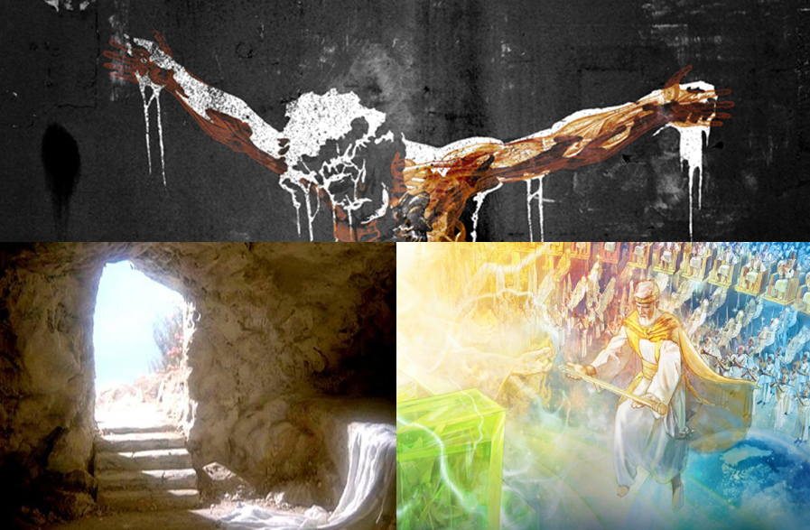
BY FAITH
LOOK TO JESUS!
The Gospel.
We are to live
the Gospel.

Slide 3
Col 3:1 If ye then be risen with Christ, seek those things which are above, where Christ sitteth on the right hand of God.

Slide 4
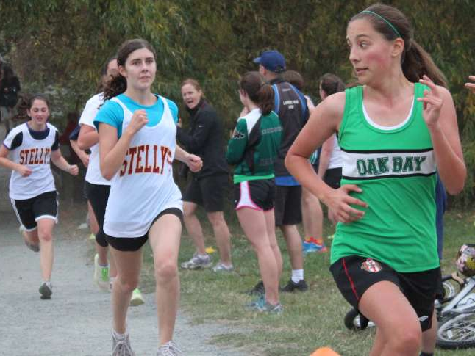
BY FAITH
Winning runners (FINISHERS) are not looking back, they look to finish.

Slide 5
Phil 3:13-16 Brethren, I count not myself to have apprehended: but this one thing I do, forgetting those things which are behind, and reaching forth unto those things which are before, 14 I press toward the mark for the prize of the high calling of God in Christ Jesus. 15 Let us therefore, as many as be perfect, be thus minded: and if in any thing ye be otherwise minded, God shall reveal even this unto you. 16 Nevertheless, whereto we have already attained, let us walk by the same rule, let us mind the same thing.

Slide 6
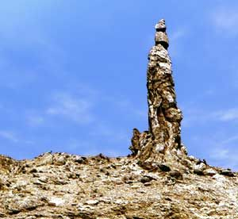
Gen 19:26 But his wife looked back from behind him, and she became a pillar of salt.
Salt formation “Lot’s Wife”
Located near the dead sea.

Slide 7
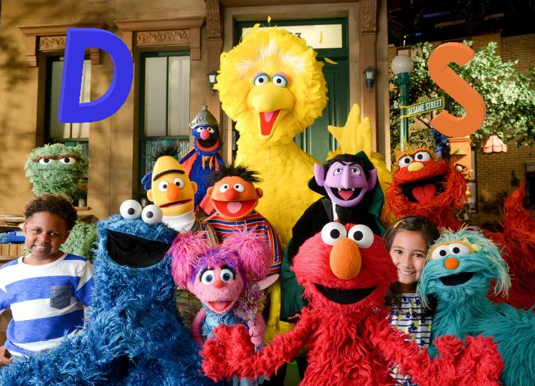

Slide 8

BY FAITH
DISCIPLINE: WE FORGET
WHAT WE DON’T WANT.

Slide 9
Proverbs 3:11-12 My son, despise not the chastening of the LORD; neither be weary of his correction: 12 For whom the LORD loveth he correcteth; even as a father the son in whom he delighteth.

Slide 10
Prov 18:2 A fool hath no delight in understanding, but that his heart may discover itself.
Prov 22:15 Foolishness is bound in the heart of a child; but the rod of correction shall drive it far from him.

Slide 11
Prov 23:13-14 Withhold not correction from the child: for if thou beatest him with the rod, he shall not die. 14 Thou shalt beat him with the rod, and shalt deliver his soul from hell.
Prov 13:24 He that spareth his rod hateth his son: but he that loveth him chasteneth him betimes .

Slide 12
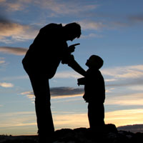
BY FAITH
WE NEED TO KNOW THAT GOD IS DISCIPLINING US AS HIS OWN CHILDREN.
Here we have God’s motive for taking us to the woodshed in life.
Discipline is proof of love.
His goal is to apply His love with force!

Slide 13
Prov 13:24 He that spareth his rod hateth his son: but he that loveth him chasteneth him betimes.
Rev 3:19 As many as I love, I rebuke and chasten: be zealous therefore, and repent.

Slide 14
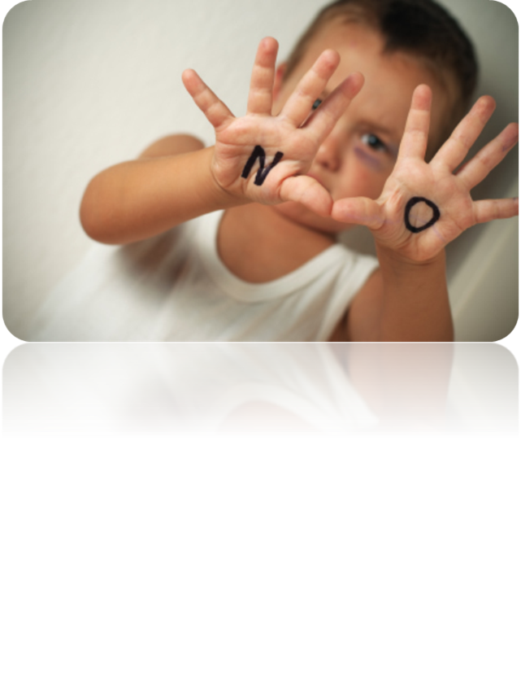
BY FAITH
WE NEED A WARNING ABOUT DISCIPLINE.
God doesn’t spank the devil’s kids.

Slide 15
Ps 119:71 It is good for me that I have been afflicted; that I might learn thy statutes.

Slide 16

BY FAITH
WE NEED TO UNDERSTAND THE REASON FOR DISCIPLINE.
God whips our tail for our benefit! Great love moves Him to give to us WHAT WE NEED.
Why do daddies discipline their kids? To teach them that they WANT to mind!

Slide 17
Ps 89:30-34 If his children forsake my law, and walk not in my judgments; 31 If they break my statutes, and keep not my commandments; 32 Then will I visit their transgression with the rod, and their iniquity with stripes. 33 Nevertheless my lovingkindness will I not utterly take from him, nor suffer my faithfulness to fail. 34 My covenant will I not break, nor alter the thing that is gone out of my lips.

Slide 18
BY FAITH
WE NEED TO UNDERSTAND THE FRUIT OF DISCIPLINE.
God disciplines us for our profit!
God wants us to be holy.

Slide 19
Prov 19:18 Chasten thy son while there is hope, and let not thy soul spare for his crying .
Prov 29:17 Correct thy son, and he shall give thee rest ; yea, he shall give delight unto thy soul.
Jer 10:24 O LORD, correct me, but with judgment; not in thine anger, lest thou bring me to nothing.

Slide 20
Discipline changes attitudes, behavior and, ABOVE ALL… hearts.

